Slide 1
Project : Renovation of Male Washroom (near the DOII)
Project Type: Faculty Facelift Projects
Project Number: 35
Committed Donors : E/85 Batch

Slide 2
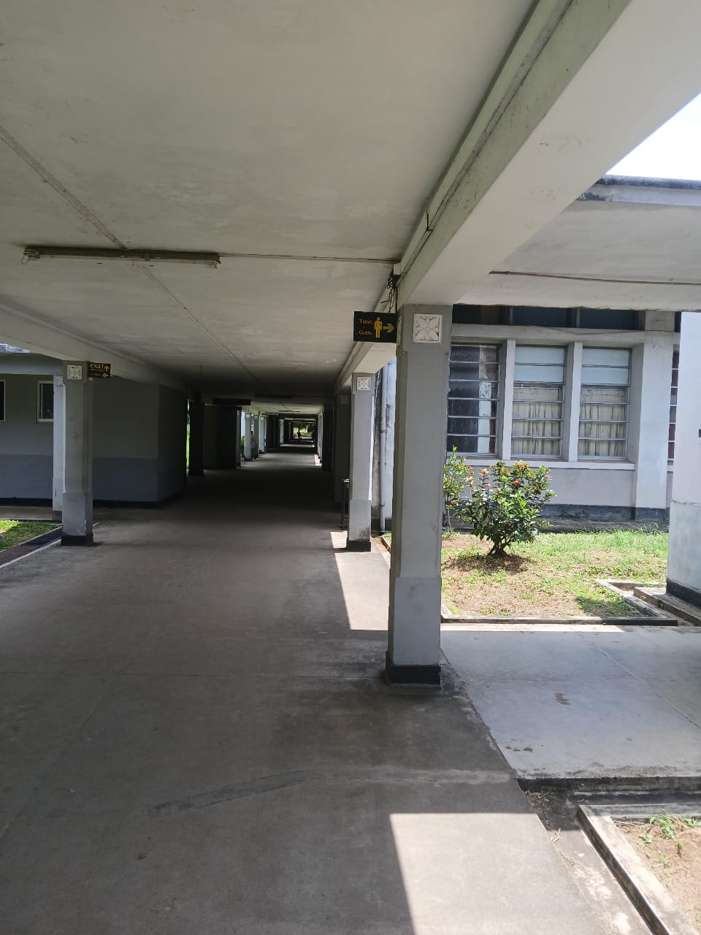
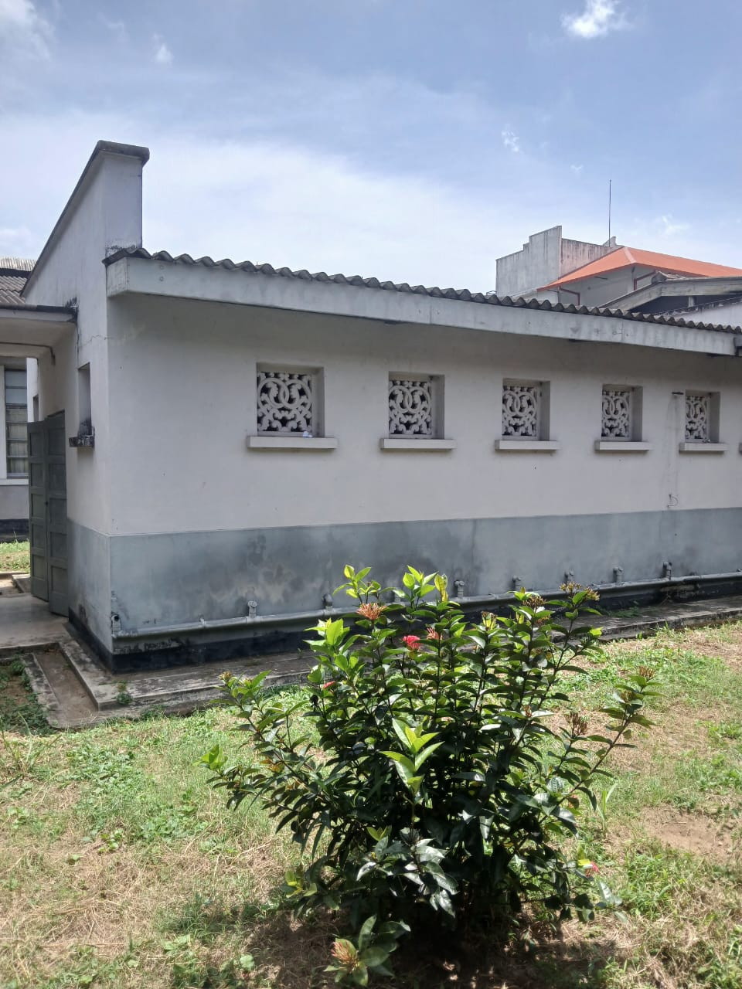
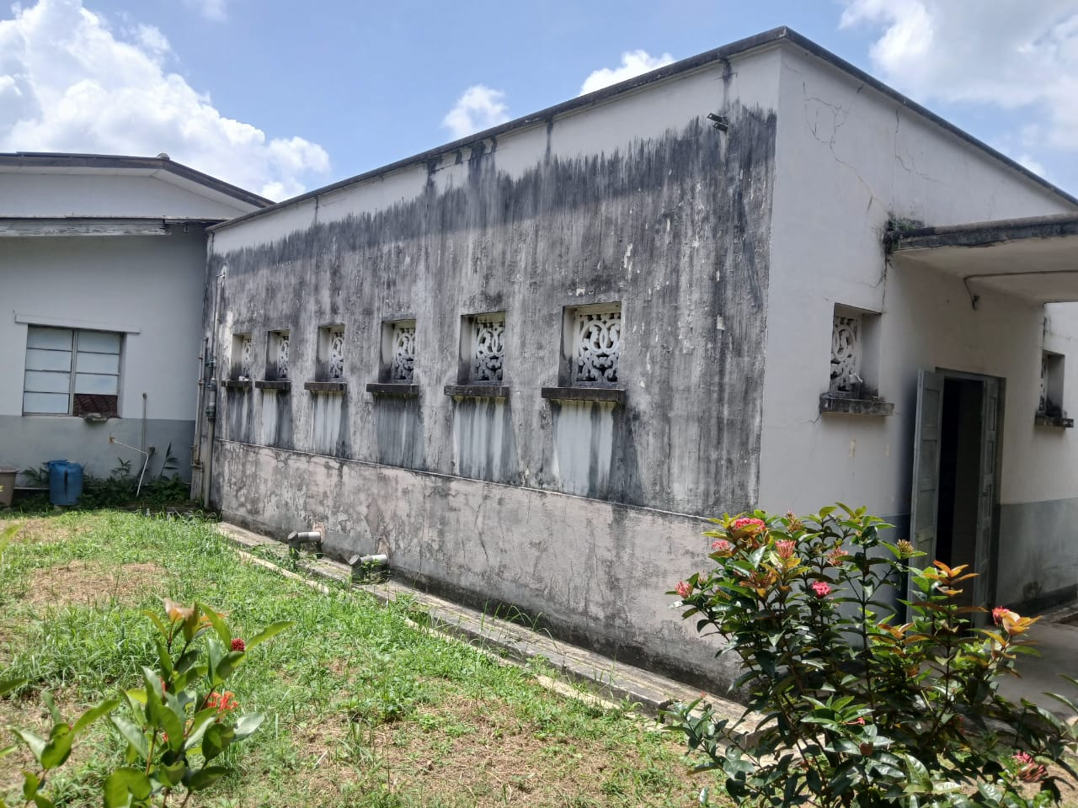
Proposed Location

Slide 3
Proposed Renovations for the Washroom

Slide 4
Bill of Materials
Serial No. | Required Item | Unit | Quantity
 | Supply and Installation of model EFI Pedestal Wash basin | Nos. | 5
 | Supply and Installation of model EFI Water Closet | Nos. | 2
 | Supply and Installation of model N091215 Cold Water Tap | Nos. | 3
 | Supply and Installation of model A603 Angle valves | Nos. | 8
 | Supply and Installation of model SD9A126 Rocell Wall Mounted Tap | Nos. | 3
 | Supply and installation of 600mm x 600 mm floor tiles of approved color. | Nos.
 | Supply and installation of 600mm x 300mm wall tiles of approved color. | Nos.
 | Tile grout of required colour | Kg
 | 500mm x 700mm Rectangular, beveled edge wall-mounted mirror - (Model FLM 5) 4mm Thickness | Nos. | 3

Slide 5
Bill of Materials Cont..
 | Supply and Installation of Pedal Dustbin | Nos. | 2
 | Supply and Installation of Wooden Detergent Rack | Nos. | 1
 | Supply and Installation of 5W LED Bulb | Nos. | 4
 | Supply and Installation of Bag Racks | Nos. | 1
 | Supply and Installation of a bathroom Doors | Nos. | 3
 | Supply and Installation of Door locks | Nos. | 3
 | Supply and Installation of IDC-A0222 Soap Wire Basket | Nos. | 4
 | Supply and Installation of Model IDC-A0308 Paper Holder | Nos. | 2
 | Supply and Installation of SCL 01 Chrome Metal Flex Bidet Spray | Nos. | 2
 | Supply and Installation of a Disable Toilet Door | Nos. | 1

Slide 6
Estimated Budget
Serial No. | Required Item | Unit | Quantity | Rate | Amount
 | Supply and Installation of model EFI Pedestal Wash basin | Nos. | 5 | 17,880.60 | 89,403.00
 | Supply and Installation of model EFI Water Closet | Nos. | 2 | 38,203.25 | 76,406.50
 | Supply and Installation of model N091215 Cold Water Tap | Nos. | 3 | 5,336.00 | 16,008.00
 | Supply and Installation of model A603 Angle valves | Nos. | 8 | 1,950.00 | 15,600.00
 | Supply and Installation of model SD9A126 Rocell Wall Mounted Tap | Nos. | 3 | 8,107.00 | 24,321.00
 | Supply and installation of 600mm x 600 mm floor tiles of approved color. | Nos. |  | - | -
 | Supply and installation of 600mm x 300mm wall tiles of approved color. | Nos. |  | 950.00 | -
 | Tile grout of required colour | Kg | - | 360.00 | -
 | 500mm x 700mm Rectangular, beveled edge wall-mounted mirror - (Model FLM 5) 4mm Thickness | Nos. | 3 | 14,776.00 | 44,328.00

Slide 7
Estimated Budget Cont..
 | Supply and Installation of Pedal Dustbin | Nos. | 2 | - | -
 | Supply and Installation of Wooden Detergent Rack | Nos. | 1 | - | -
 | Supply and Installation of 5W LED Bulb | Nos. | 4 | - | -
 | Supply and Installation of Bag Racks | Nos. | 1 | - | -
 | Supply and Installation of a bathroom Doors | Nos. | 3 | - | -
 | Supply and Installation of Door locks | Nos. | 3 | - | -
 | Supply and Installation of IDC-A0222 Soap Wire Basket | Nos. | 4 | 13,955.00 | 55,820.00
 | Supply and Installation of Model IDC-A0308 Paper Holder | Nos. | 2 | 7,696.00 | 15,392.00
 | Supply and Installation of SCL 01 Chrome Metal Flex Bidet Spray | Nos. | 2 | 9,113.00 | 18,226.00
 | Supply and Installation of a Disable Toilet Door | Nos. | 1 | - | -
 | Sub Total |  |  |  | 355,504.50

Slide 8
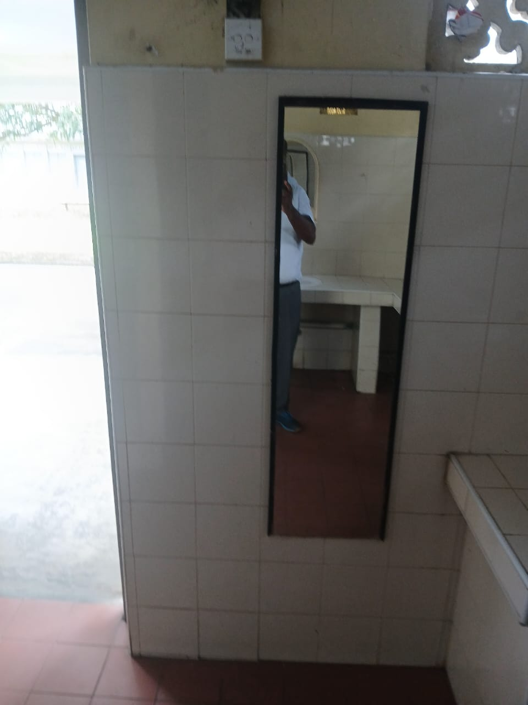
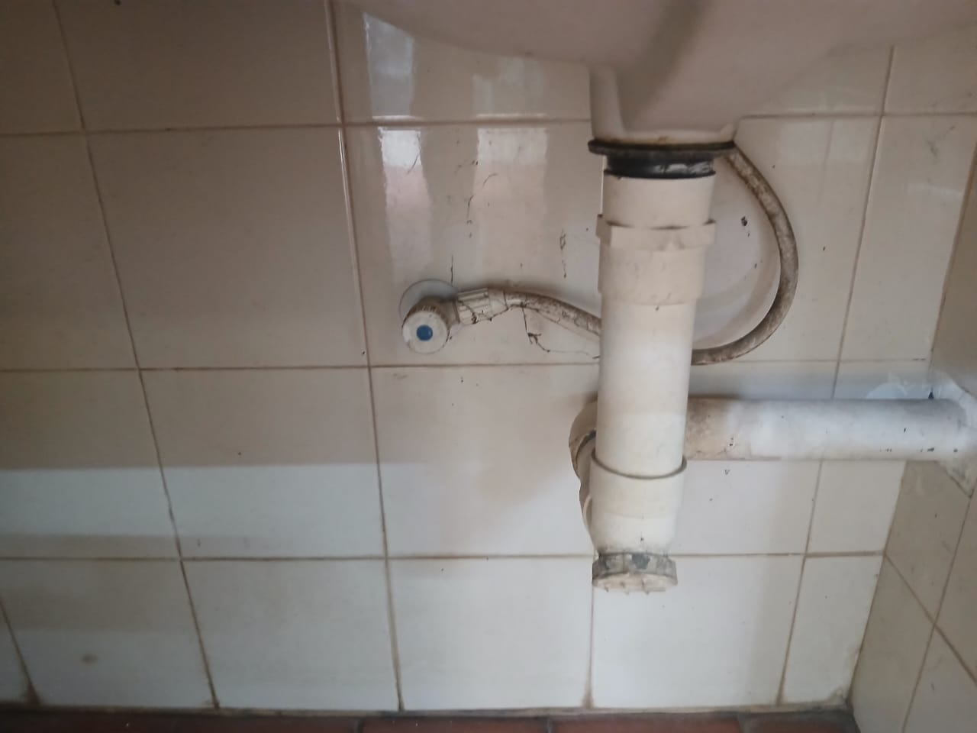
Current situation of the Washroom

Slide 9
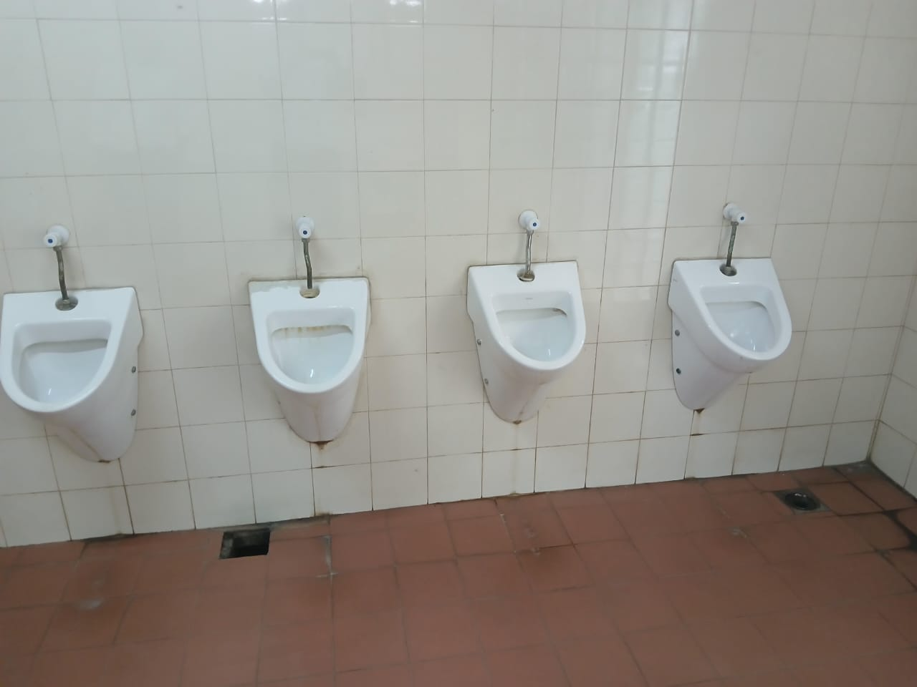
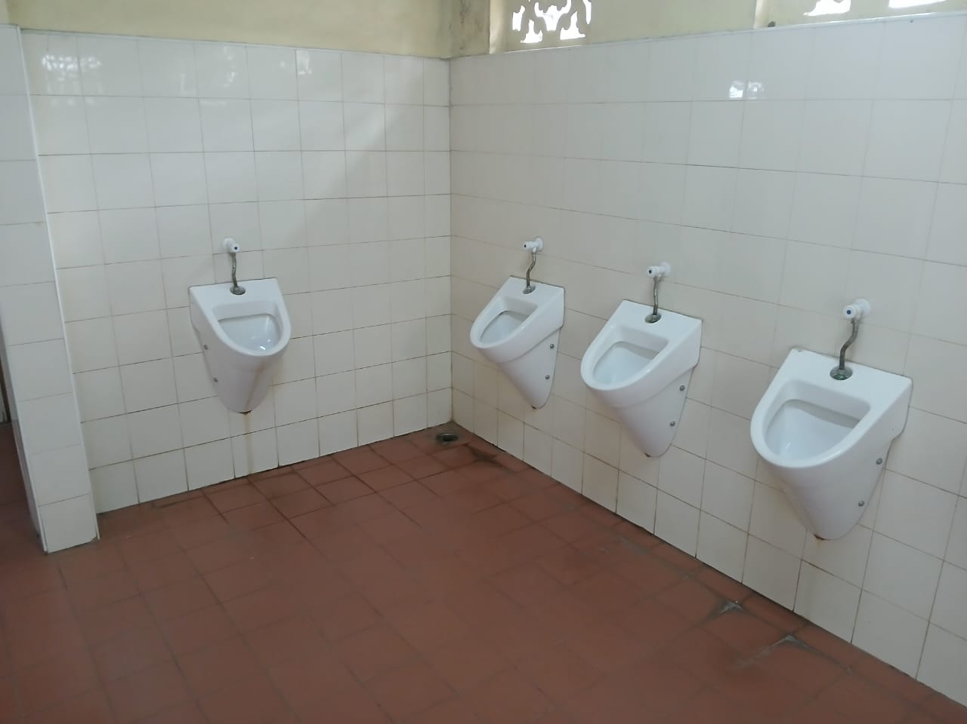
Current situation of the Washroom Cont..

Slide 10
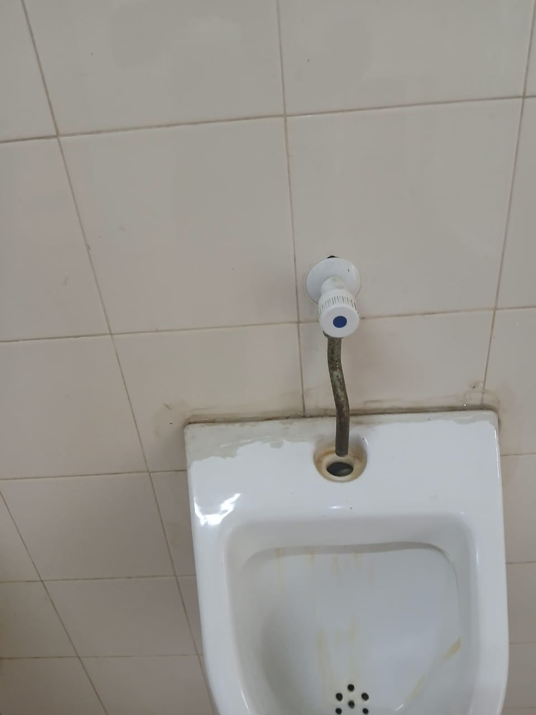
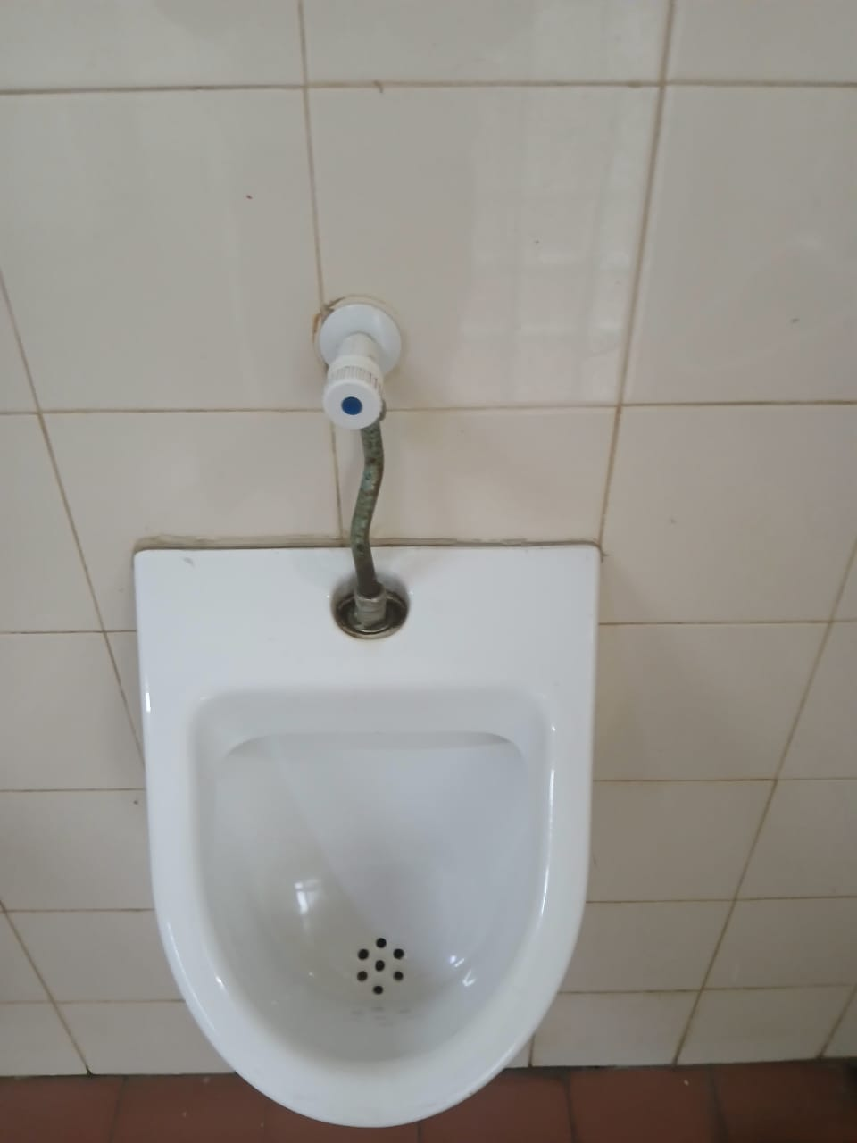
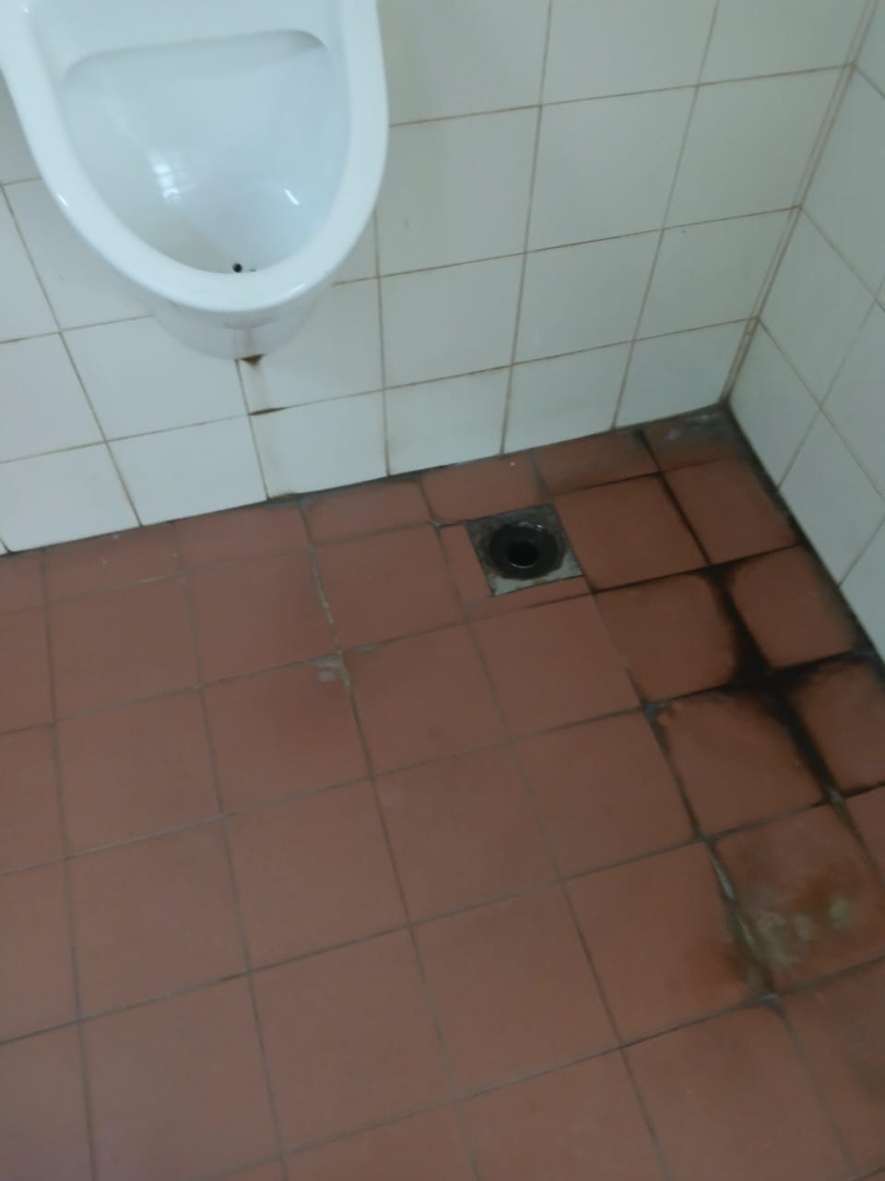
Current situation of the Washroom Cont..

Slide 11
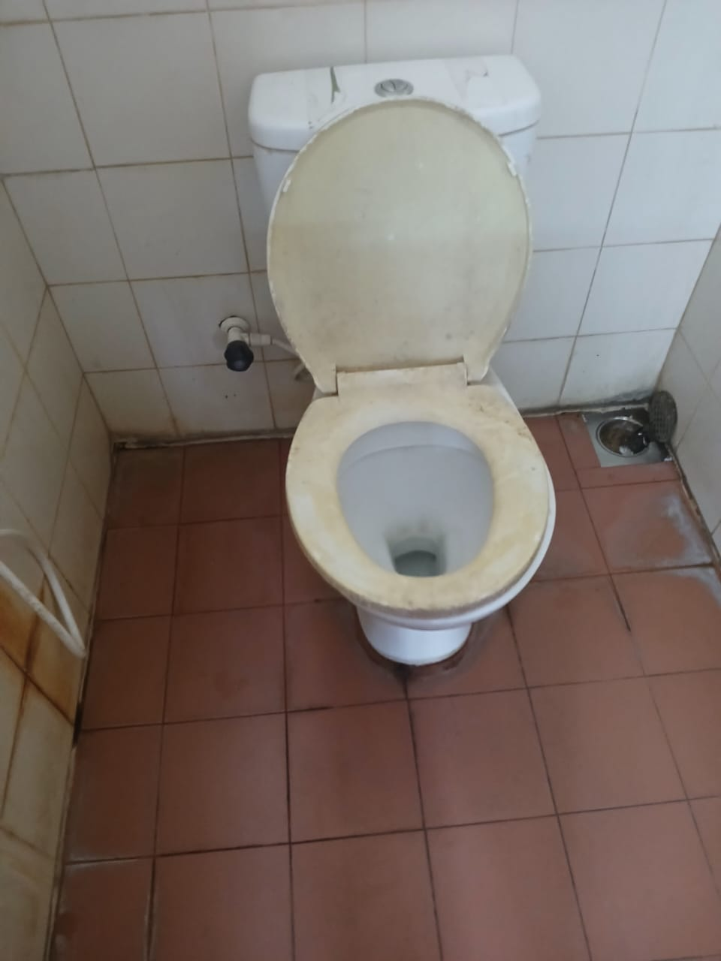
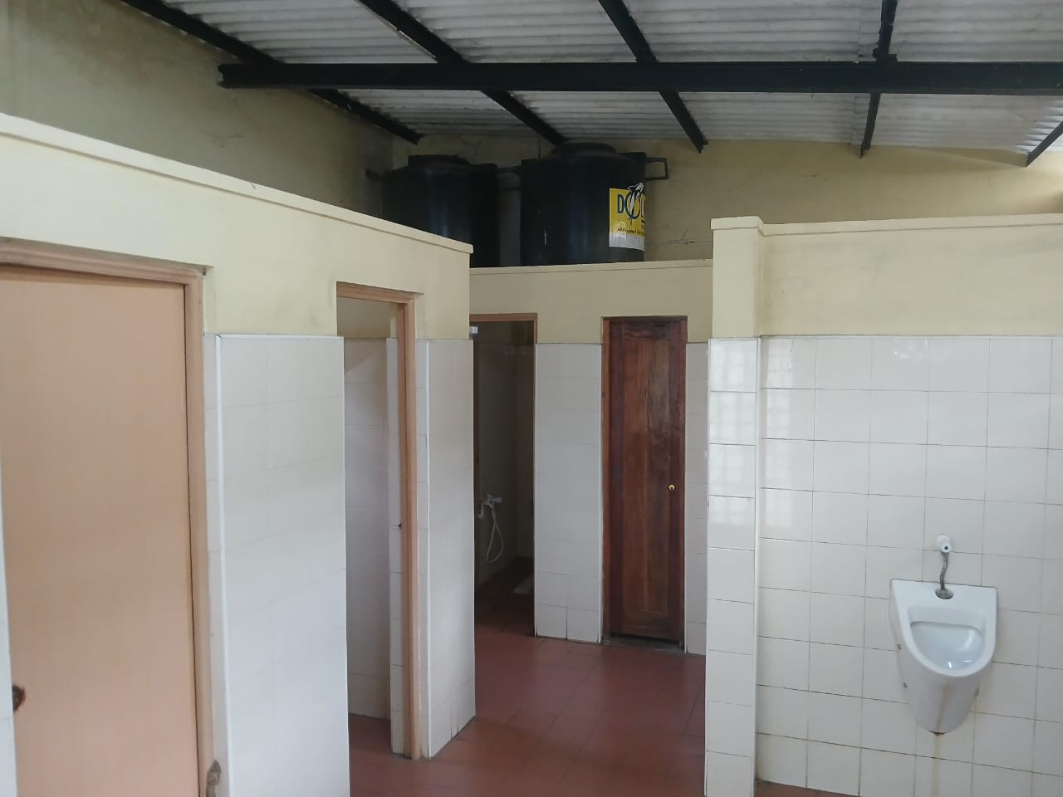
Current situation of the Washroom Cont..

Slide 12
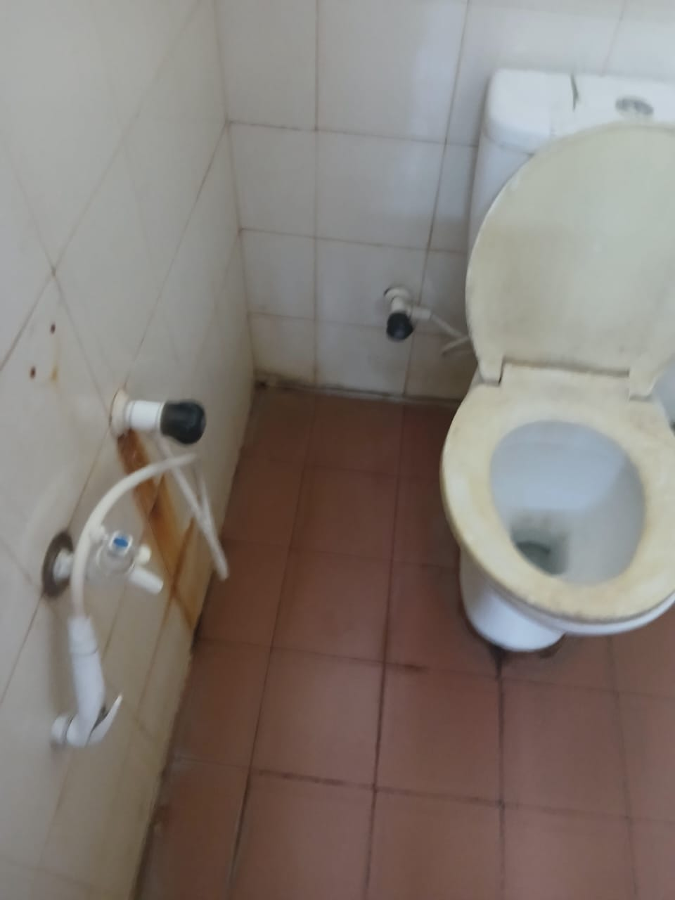
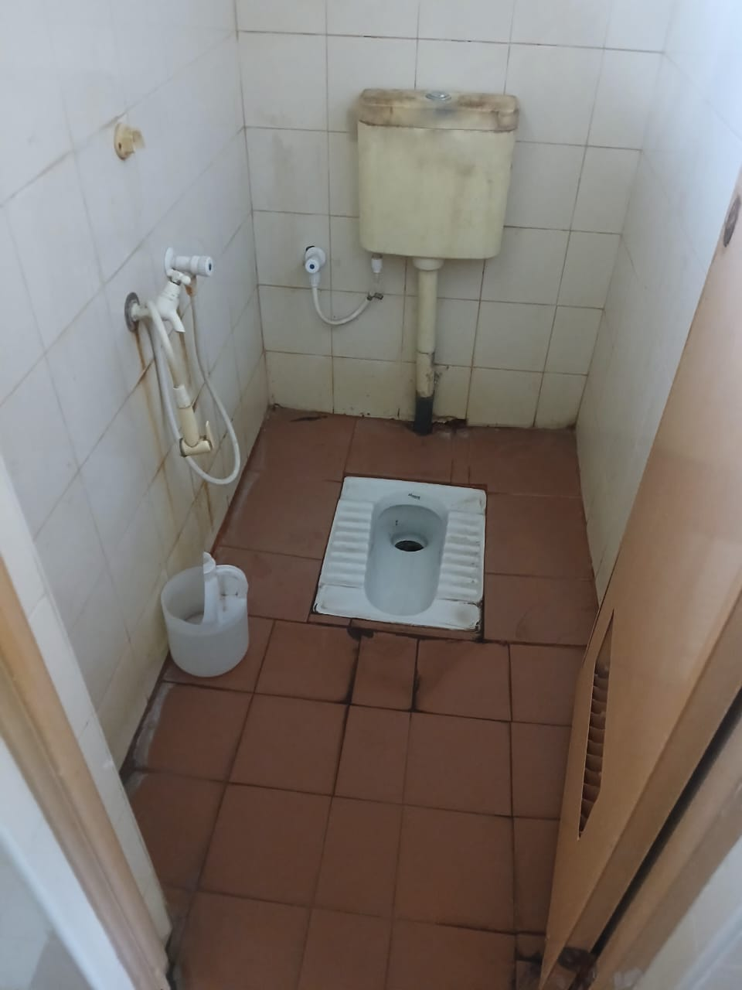
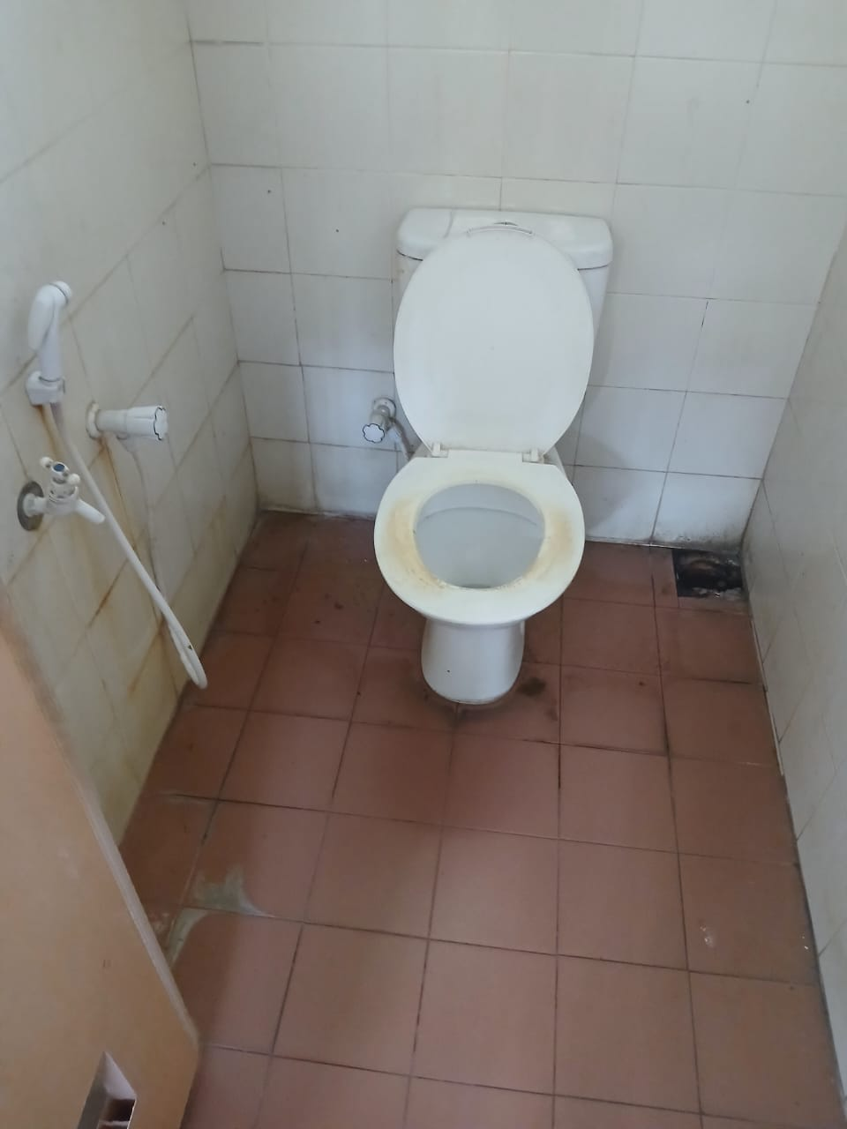
Current situation of the Washroom Cont..

Slide 13
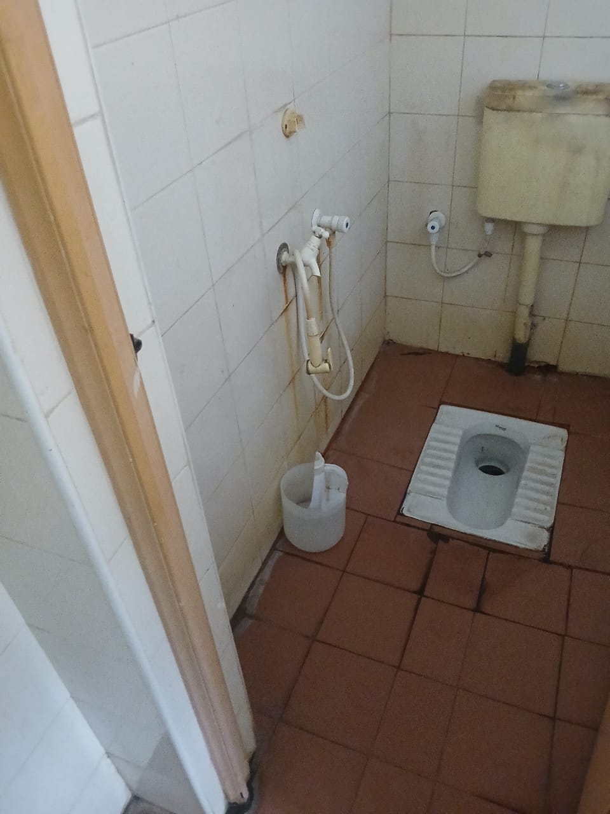
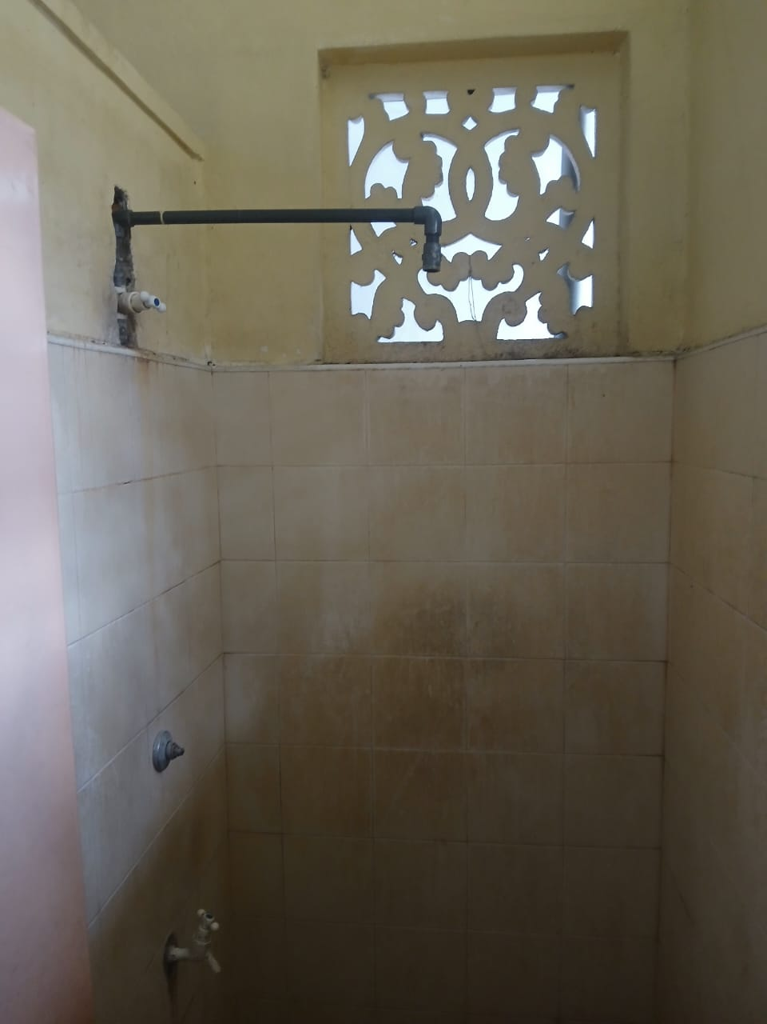
Current situation of the Washroom Cont..

Slide 14
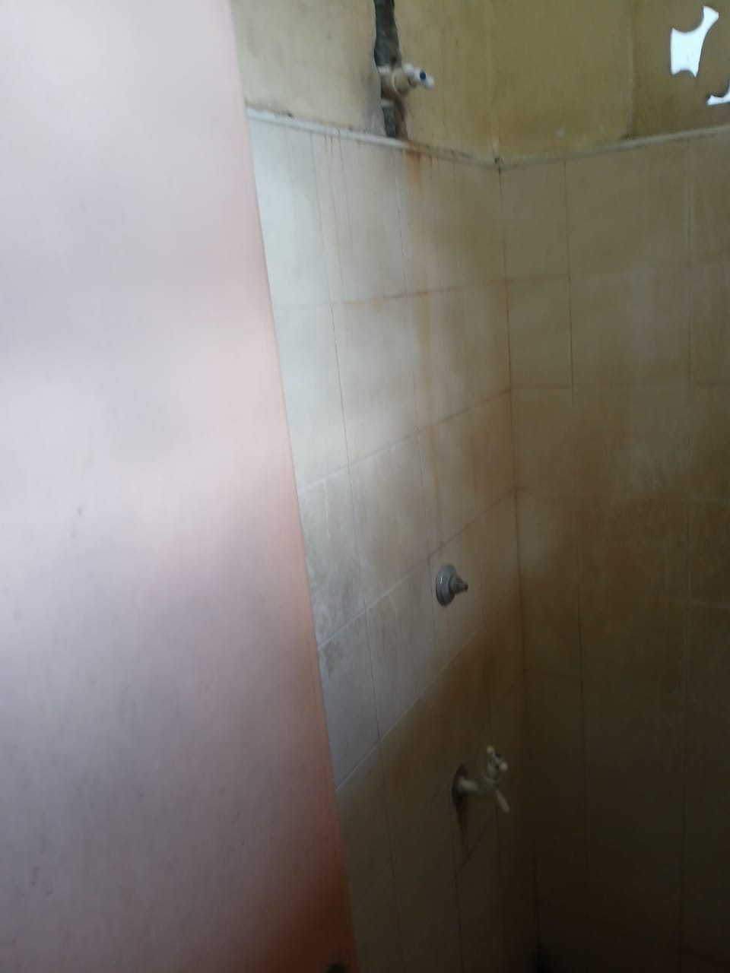
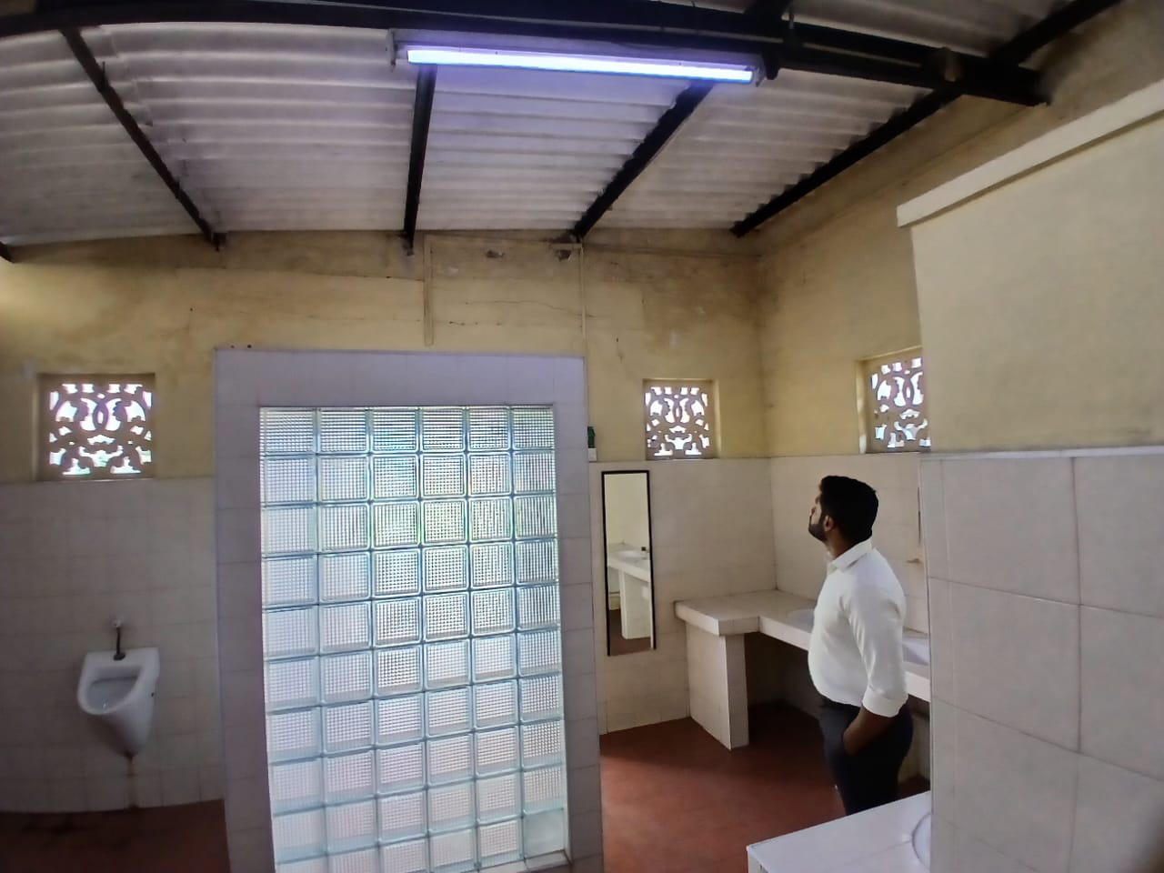
Current situation of the Washroom Cont..

Slide 15
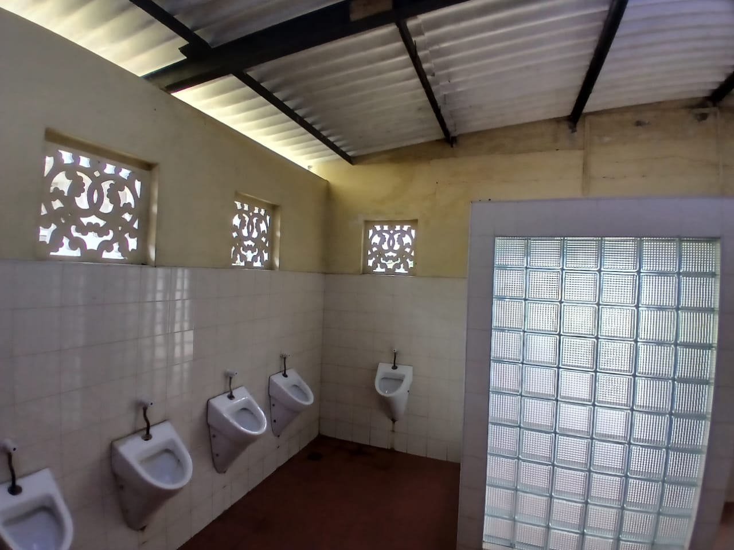
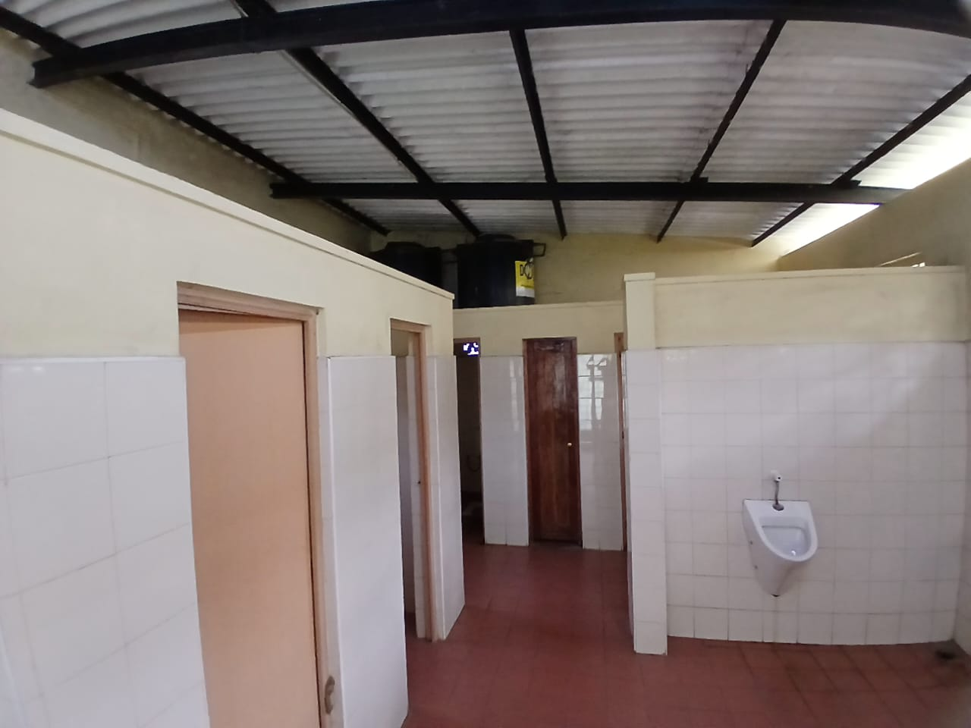
Current situation of the Washroom Cont..

Slide 16
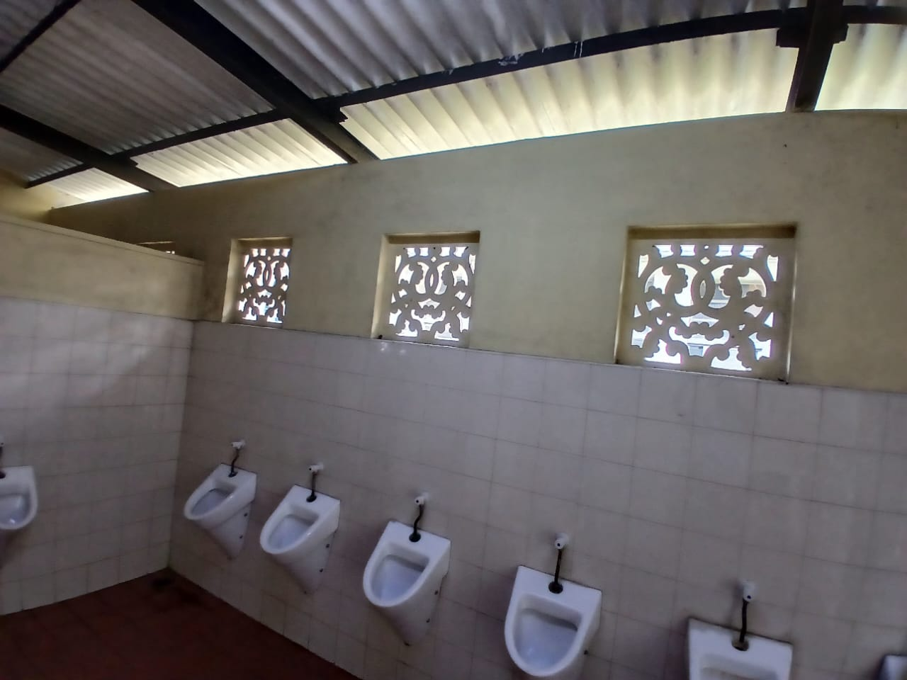
Current situation of the Washroom Cont..

